Slide 1

Project 2 Brazilian E-Commerce Public Dataset by Olist
https://www.kaggle.com/olistbr/brazilian-ecommerce/code

Slide 2
Background
Olist, a Brazilian e-commerce marketplace integrator
Is an online e-commerce site aggregation platform designed to facilitate direct sales on e-commerce sites of Brazil
The company's platform connects entrepreneurs with major online retailers and allows shopkeepers to advertise and sell in the marketplaces without complication, enabling retail companies to reach out to the international marketplaces, improve the shopping experience and modify their purchasing behavior
Olist connects small businesses from all over Brazil to channels without hassle and with a single contract. Those merchants are able to sell their products through the Olist Store and ship them directly to the customers using Olist logistics partners

Slide 3
Business Question
Customer’s Segmentation
How should we priorities and categories customers?
What should we do to bring in more sales?
Seller’s Segmentation
What can we do to on-board more company or retailer to sell their products on the platform?
Do we need to remove seller who are inactive in the platform?

Slide 4
Data Description
Order_items Data
1 | order_id
2 | order_item_id
3 | product_id
4 | seller_id
5 | shipping_limit_date
6 | price
7 | freight_value
Order Data
1 | order_id
2 | customer_id
3 | order_status
4 | order_purchase_timestamp
5 | order_approved_at
6 | order_delivered_carrier_date
7 | order_delivered_customer_date
8 | order_estimated_delivery_date
Customer Data
1 | customer_id
2 | customer_unique_id
3 | customer_zip_code_prefix
4 | customer_city
5 | customer_state
Payment_detail Data
1 | order_id
2 | payment_sequential
3 | payment_type
4 | payment_installments
5 | payment_value
Products Data
1 | product_id
2 | product_category_name
3 | product_name_lenght
4 | product_description_lenght
5 | product_photos_qty
6 | product_weight_g
7 | product_length_cm
8 | product_height_cm
9 | product_width_cm
Review Data
1 | review_id
2 | order_id
3 | review_score
4 | review_comment_title
5 | review_comment_message
6 | review_creation_date
7 | review_answer_timestamp
Geolocation Data
1 | geolocation_zip_code_prefix
2 | geolocation_lat
3 | geolocation_lng
4 | geolocation_city
5 | geolocation_state
Seller Data
1 | seller_id
2 | seller_zip_code_prefix
3 | seller_city
4 | seller_state

Slide 5
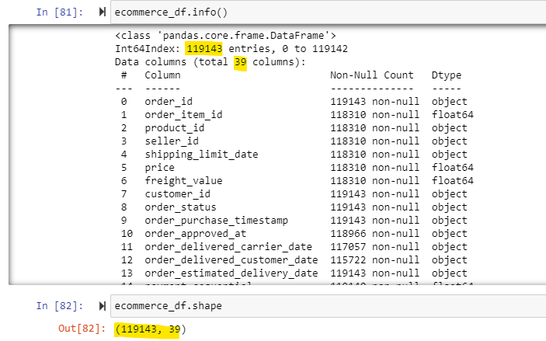
Data Description
Data date range: October 2016 to August 2018
Data consist of 119143 rows and 39 columns
Drop NaN value
Drop 11 columns which I will not use

Slide 6
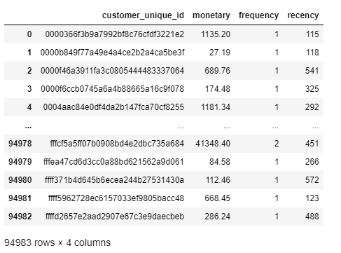
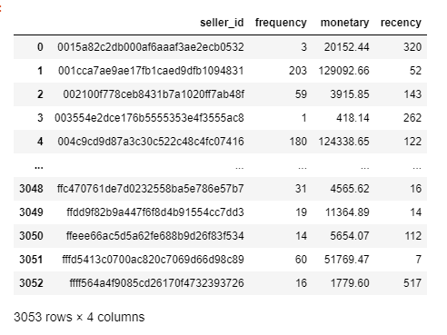
Data Description
Add column to separate customer purchase the months and years
Add column to calculate Recency, Monetary and Frequency
Customer RFM data table
Seller RFM data table

Slide 7
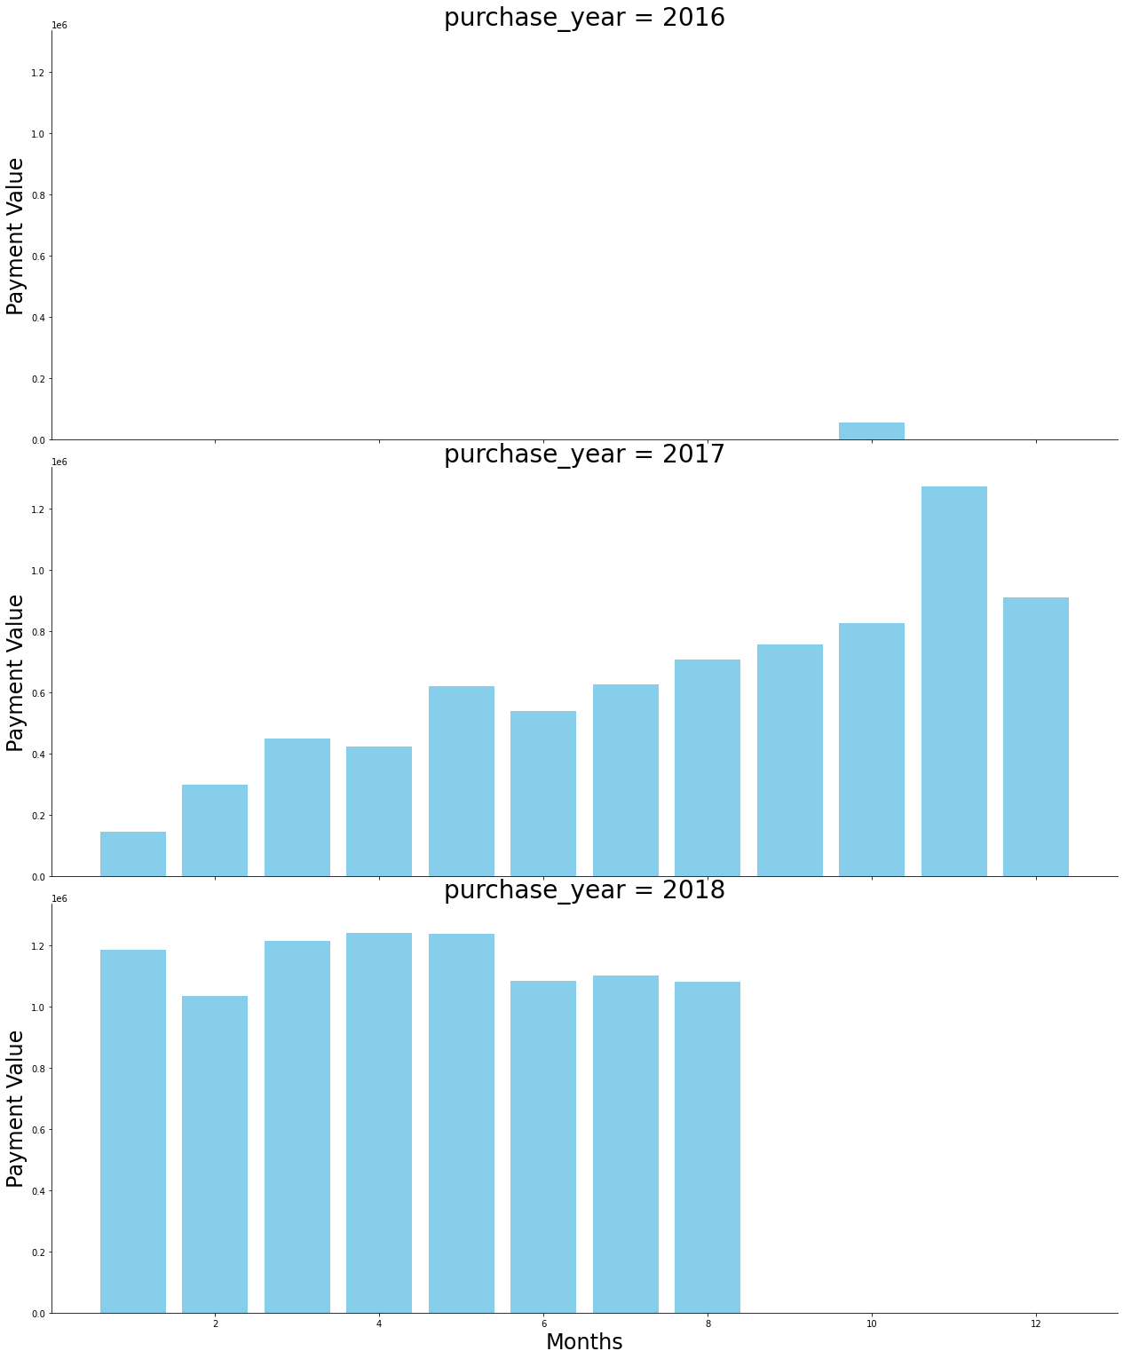
Growing trend

Slide 8
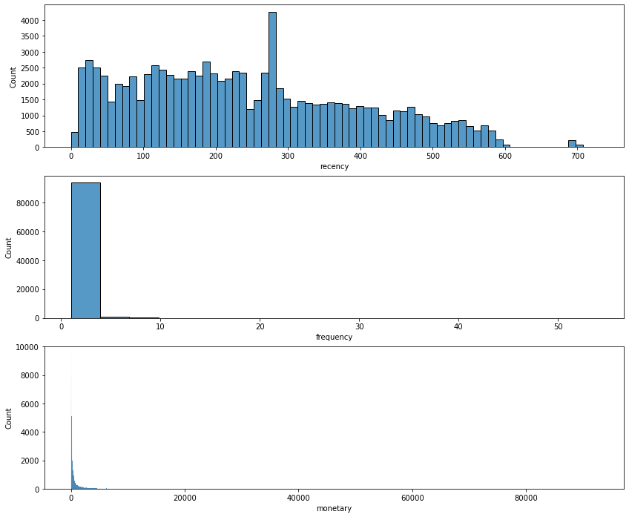
Customer’s Segmentation
Using RFM analysis

Slide 9
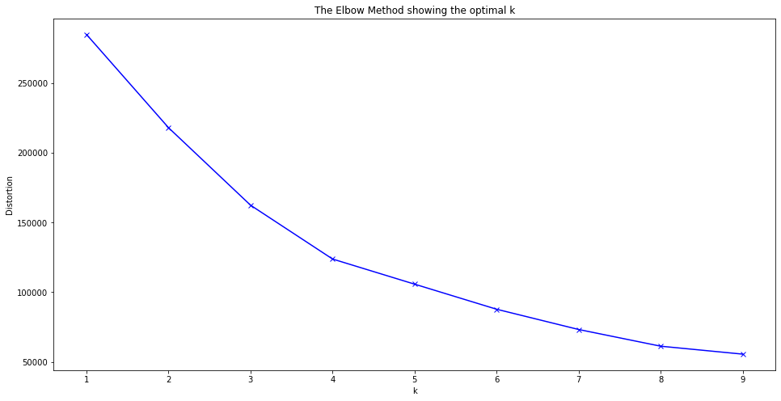
Customer’s Segmentation: K Means
Optimal K value is 4

Slide 10
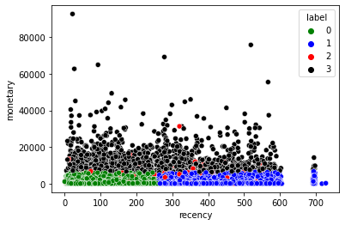
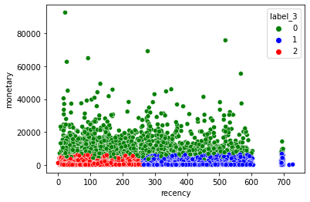
Customer’s Segmentation: K Means
N_Cluster = 4
N_Cluster = 3
Conclusion
N = 3 Cluster separate the data better
The data does not show that the more you purchases online is equal to the more you spend
Can focus build better customer relationship to ensure that the platform uphold a standard of trust.

Slide 11
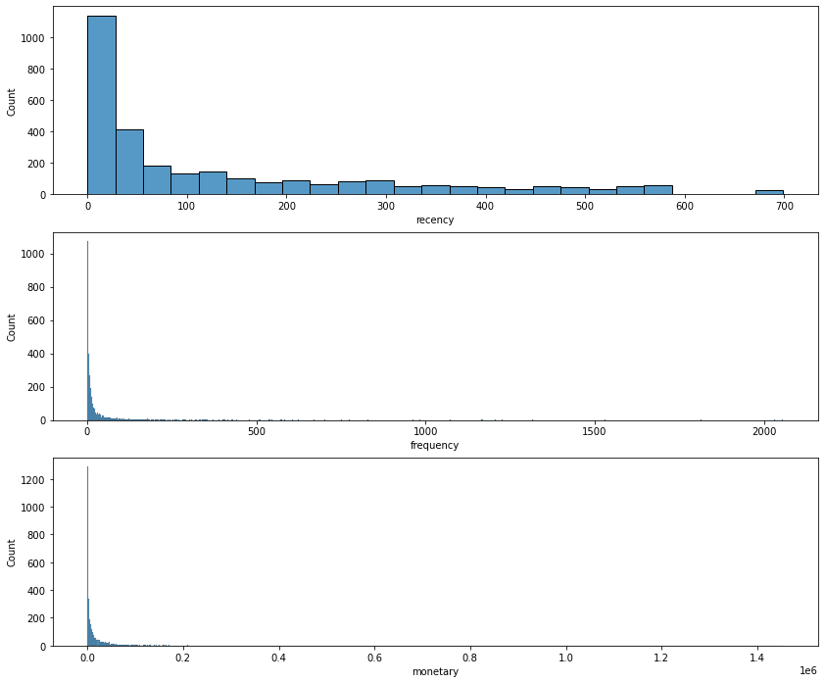
Seller Segmentation
Using RFM analysis

Slide 12

Seller Segmentation: K Mean
Optimal K value is 4

Slide 13
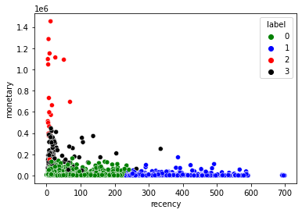
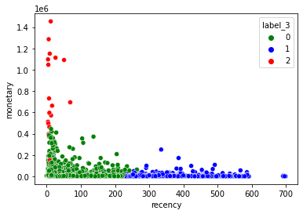
Seller Segmentation: K Mean
N_Cluster = 4
N_Cluster = 3
Conclusion
N = 3 Cluster separate the data better
The data show that sellers who are more active are earning more money
Inactive seller who is not online we can start to remove them

Slide 14
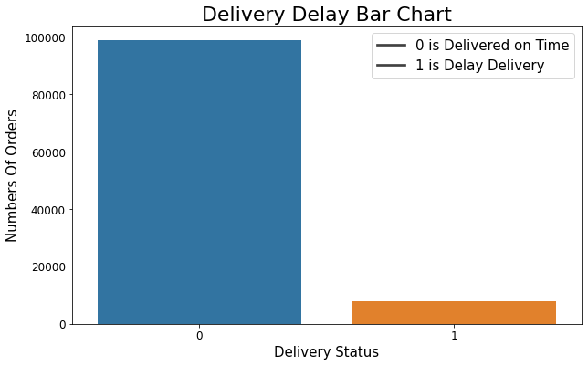
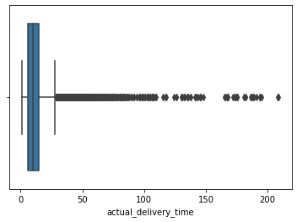
Seller Segmentation: Delivery Status
Delivery Status Bar Chart
0 is 98780 delivered on time
1 is 7747 delivery is late
Outlier Chart for actual delivery time

Slide 15
Looking Forward
Check the review scores and review comment to segregate between customers satisfaction of the platform
To get more data on the reasons of late delivery to uphold a high standard and reputations
To analysis why some sellers can get sales more frequent than the others
To include on data on customer’s shopping behaviours

Slide 16
Q & A

